Slide 1

RANDOM PASSWORD GENERATOR
PYTHON PROGRAMMING BASIC PROJECT
DATA SCIENCE AND MACHINE LEARNING
(PGDDM-34)
By-
DEVATHA SHIVSHYL
Reg No- R20230717341832

Slide 2

INTRODUCTION

Slide 3
INTRODUCTION
Password Generator is used in a way through which highly secure password are generated that is really hard to crack or hack
Passwords are a means by which a user proves that they are authorized to use a device.
A strong password is a key to protect your personal assets online.
It is important that passwords must be long and complex.
It should contain at least more than ten characters with a combination of characters such as percent (%), commas(,) and parentheses as well as lower-case and upper-case alphabets and numbers.
Here we will create a random password using Python code.
Example of a weak password : password123
Example of a strong password : &gj5hj&*178a1

Slide 4




ABOUT PYTHON

Slide 5
ABOUT PYTHON
Python is an easy to learn, powerful programming language.
it has efficient high level data structure and a simple but effective approach to object oriented programming
features of Python
Simple
Easy to learn
Free and open source
High level language portable
Object oriented
Interpreted

Slide 6

MODULES NEEDED

Slide 7
String Module – For accessing string constants.
String.ascii letters:
ASCII is a system that is used to represent characters digitally, every ASCII character has its own unique code.
string.ascii_letters is a string constant which contains all the letters in ASCII ranging from A to Z and a to z.
Its value is non-locale dependent and it is just a concatenation of ascii_uppercase and ascii_lowercase.
Thus it provides us the whole letter set as a string that can be used as desired.

Slide 8
String digits:
This is a pre-initialized string that contains all the digits in the Arabic numeral system i.e. 0, 1, 2, 3, 4, 5, 6, 7, 8, 9.
It should be kept in mind that even though these are digits, the type is still a string constant, and all digits are concatenated like this – “0123456789”.
If we want to access specific numbers then we can do so using slicing.
Syntax : string.digits
Parameters : Doesn’t take any parameter, since it’s not a function.
Returns : Return all digit letters.

Slide 9
Random Module –
The python random module helps a user to generate pseudo-random numbers.
Inside the module, there are various functions that just depend on the function “random()”.
This function generates a random float uniformly in the semi-open range [0.0, 1.0) i.e. it generates a decimal number greater than or equal to 0 and strictly less than one. Other functions use this number in their own ways.
These functions can be used for bytes, integers, and sequences. for our task, we are interested in sequences.
There are functions random. choices that take in a sequence as its argument and return a random element from that sequence.

Slide 10

ALGORITHM

Slide 11
ALGORITHM
The main algorithm for password generation contains a FOR loop, which does the following:
generates a random number between 1 and 4 to choose the character set
once the set has been randomly selected, a random index will be generated for the selected character set
the index is used to choose the new character to be added to the previous character
The FOR loop is executed until the password length is reached.
Finally the password is displayed in the console.

Slide 12
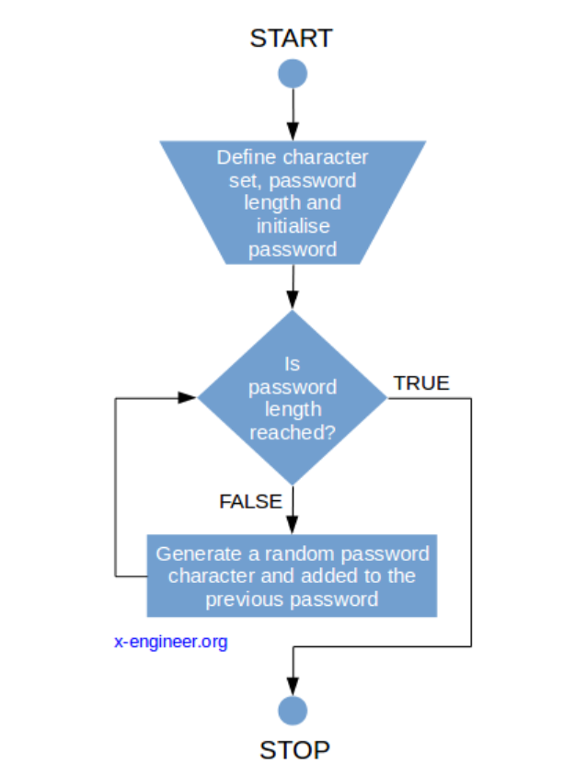
FLOW CHART

Slide 13

CODE IMPLEMENTATION

Slide 14
Code Implementation
Firstly ,ask the user if they want to generate a password or not
If yes, take the length of the password as input
Call the function Generate Password
Print the Generated Password
If initial response is no, Exit the program

Slide 15
APPLICATIONS
User Account Creation: When users sign up for a website or application, you can generate a random password for them, ensuring it meets security requirements.
Password Recovery: If users forget their passwords, you can generate a temporary random password for them to reset their account access.
Secure File Encryption: Generate random keys for encrypting sensitive files or data to enhance security.
API Key Generation: When developing applications that use APIs, you may need to generate API keys. Randomly generated keys are more secure than manually created ones.
Database Credentials: For database connections, you can generate random usernames and passwords for database users to enhance security.
Password Manager Integration: Password manager applications can use random password generators to create and store complex passwords for users.

Slide 16
ADVANTAGES
Security: Randomly generated passwords are typically more secure than passwords created by humans because they are less predictable. This reduces the risk of password guessing and brute-force attacks.
Complexity: You can customize the complexity of the generated passwords by specifying the length and the types of characters (e.g., uppercase letters, lowercase letters, numbers, special symbols). This ensures that the passwords meet your security requirements.
Ease of Use: It's easy to create and use a random password generator in Python. You can incorporate it into your applications, scripts, or websites with minimal effort.
Customization: You can tailor the generator to your specific needs. For example, you can exclude certain characters that might cause issues in your system, or you can ensure that the generated passwords comply with specific password policies.
Avoiding Common Words: Random password generators can avoid using common words or phrases that could be easily guessed, which is a common weakness in user-created passwords.

Slide 17
CODE
import random
import string
characters = list(string.ascii_letters +string.digits +"!@#$^&%*()")
def generate_password():
password_length = int(input("length of password u need to have ? "))
random.shuffle(characters)
password = []
for i in range (password_length):
password.append(random.choice(characters))
random.shuffle(password)
password = "".join(password)
print(password)
option = input("Do you want to generate a password Yes or No ")

Slide 18
if option =="Yes":
generate_password()
elif option == "No":
print("End ")
exit()
else:
print("invalid option")
exit()

Slide 19
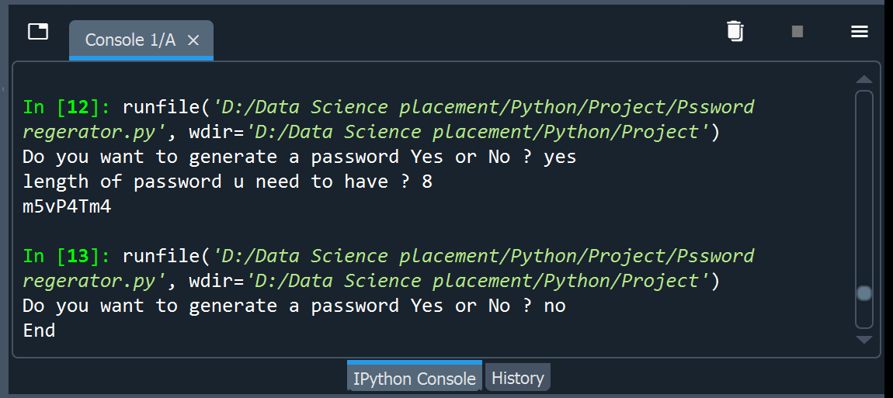
OUTPUT

Slide 20
CONCLUSION
A random password generator is an essential tool for enhancing security in the digital age.
We've explored how Python can be used to create a robust and customizable password generator.
Strong, randomly generated passwords are a crucial defense against cyber threats such as brute force attacks and password guessing.
Implementing a random password generator not only improves individual security but also contributes to overall digital safety.
Let's commit to using and promoting the use of random password generators to protect our online identities and assets.

Slide 21
